Slide 1
RDBMS IA 1
Name: - Kamal Rohra
Roll No: -1911111
Batch: - B3

Slide 2
Criminal Identification System Using Face Detection and Recognition
Authors: - Piyush Kakkar1 , Mr. Vibhor Sharma2

Slide 3
INTRODUCTION
The face is crucial for human identity. It is the feature which best distinguishes a person.
Face recognition is an interesting and challenging problem which have multiple uses for many different purposes
Since we don’t see the world as scattered pieces, our visual senses must somehow combine the different sources of information into useful patterns this makes Face recognition an easy task for humans. But it’s entirely different task for a computer.
Automatic face recognition is all about extracting meaningful features from an image such as inner features (eyes, nose, mouth) or outer features (head shape, hairline) and putting them into a useful representation and performing some classifications on them
Face recognition based on the geometric features of a face is probably the most instinctive approach for Human face identification
The whole process can be divided in three major steps which will be discussed in the upcoming slide

Slide 4
3 Major steps
Step-1 : - finding a good database of faces with multiple images for each individual.
Step-2 : - detect faces in the database images and use them to train the face recognizer
Step-3 : - test the face recognizer to recognize faces it was trained for

Slide 5
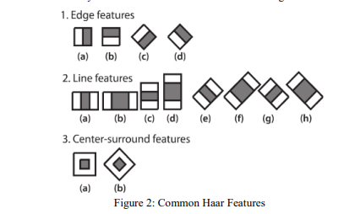
Understanding about face recognition
Face recognition is not done directly by the computers and hence needs to be divided into subtasks
Different haar-like features are used to abstract different features of the faces
A simple rectangular Haar-like feature can be defined as the difference of the sum of pixels of areas inside the rectangle, which can be at any position and scale within the original image

Slide 6
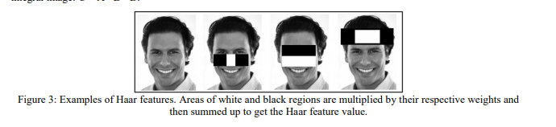
Each Haar feature has a value that is calculated by taking the area of each rectangle, multiplying each by their respective weights, and then summing the results

Slide 7
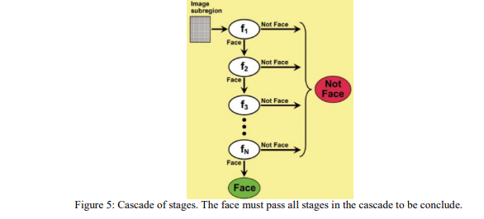
Face detection algorithms generally work in the cascade of stages
The cascade eliminates candidates by making stricter requirements in each stage with later stages being much more difficult for a candidate to pass
Candidates exit the cascade if they pass all stages or fail any stage. A face is detected if a candidate passes all stages

Slide 8
Step-1
Step 1 requires a creation of data set which can be done by uploading multiple images of the particular face that needs to be identified
Try and keep the face images as clear as possible to avoid wrong detections

Slide 9
Implementation
Implementation will be divided into subtopics as shown below: -
Importing the required modules
Load the face detection Cascade
Create the Face Recognizer Object
Prepare the training set and Perform the training
Testing

Slide 10
Import the required modules
Required modules and uses: -
Cv2 : - cv2 is the OpenCV module and contains the functions for face detection and recognition
os: - OS will be used to maneuver with image and directory names
image module : - Since, the dataset images are not in the same format as supported by openCV OpenCV ,Image module from PIL is used to read the image in grayscale format
numpy : - Numpy arrays are used to store the images.

Slide 11
Loading the face detection Cascade(step-II)
To Load the face detection cascade the first step is to detect the face in each image and after that ROI(i.e face) is used for training the recognizer
For the purpose of face detection, we will use the Haar Cascade provided by OpenCV
You can find the harcascade file for frontalface detection on github having the name haarcascade_frontalface_default.xml
Cascade is loaded using the cv2 CascadeClassifier function which takes the path to the cascade xml file. if the xml file is in the current working directory, then relative path is used.

Slide 12
Create the Face Recognizer Object
This step involves creating the face recognizer object. The face recognizer object has functions like FaceRecognizer.train() to train the recognizer and FaceRecognizer.predict() to recognize a face
Opencv provides multiple recognizers but the one that was used is Local Binary Patterns Histograms(LBPH)
We can’t guarantee perfect light settings in your images or 10 different images of a person thus LBPH focus on extracting local features from images
Local patterns are generally obtained by comparing each pixel with its neighbouring pixels

Slide 13
Preparing the training set and Performing the training
Testing (step-III)
Function that is used to prepares the training set requires absolute path to the labeled image database having as input argument and returns the faces and corresponding labels
The training function requires two inputs
The features which in this case are the images of faces
The corresponding labels assigned to these faces
Finally For testing the Face Recognizer, we check if the recognition was correct by seeing the predicted label when we bring the trained face in front of camera

Slide 14
RESULTS

Slide 15
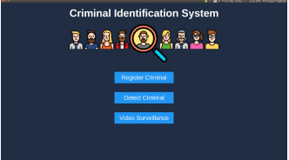
Home page
Homepage is the main page of Criminal Identification System application. It contains three buttons for: Register Criminal, Detect Criminal and Video Surveillance.

Slide 16
Criminal Registration
Criminal Registration page will ask the user to select atleast 5 images of the criminal that needs to be registered and also provides input form for providing various details of the criminal like his Name, DOB, Identification mark, Profile picture etc. After selecting images and filling details, user will click register. The criminal will be successfully registered if any error doesn’t occur.

Slide 17
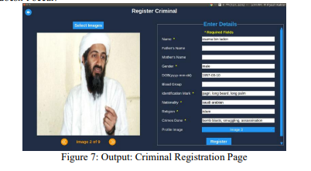

Slide 18
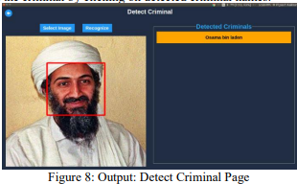
Detect Criminal Page
This page. allows the user to browse an image from the system and helps in detecting one or more criminals in it. User can also see the profile of the criminal by clicking on detected criminal names.

Slide 19
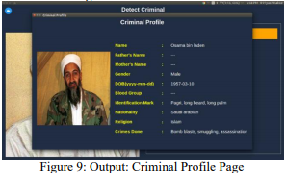
Criminal Profile Page
This page will show criminal profile after clicking criminal name from detect criminal or video surveillance page

Slide 20
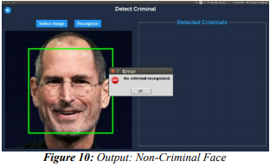
Detecting Unknown Criminal
This system is able to identify a non-criminal face.

Slide 21
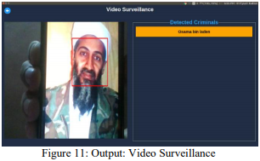
Video Surveillance
This page will use the pc webcam to capture the video frames in real time. After this it will use face detection module on each frame to detect and recognize criminals in the video in real time. User can also see the profile of the criminal by clicking on detected criminal names.

Slide 22
Conclusion
Thus with the help of this case study we understood how we can implement the face detections and thus recognizing the criminals and also understanding the intuition of how face detection can be achieved
Several advantages of this algorithm are: Efficient feature selection, Scale and location invariant detector, instead of scaling the image itself, we scale the features Such a generic detection scheme can be trained for detection of other types of objects (e.g. cars, sign boards, number plates etc). LBPH recognizer can recognize faces in different lighting conditions with high accuracy
This application also has some disadvantages like: Detector is most effective only on frontal images of faces, it can hardly cope with 45° face rotation both around the vertical and horizontal axis

Slide 23
REFERENCES
Belhumeur, P. N., Hespanha, J. P., & Kriegman, D. J. (1997). Eigenfaces vs. Fisherfaces: Recognition Using Class Specific Linear Projection. IEEE Transactions on Pattern Analysis and Machine Intelligence. 19, pp. 711-720. IEEE Computer Society
Bornet, O. (2005, May 19). Learning Based Computer Vision with Intel's Open Source Computer Vision Library. Retrieved April 2007, 2007, from Intel.com Website: http://www.intel.com/technology/itj/2005/volume09issue02/art03_learning_vision/p04_face_dete ction.htm
Brunelli, R., & Poggio, T. (1993). Face Recognition: Features versus templates. IEEE Transaction on Pattern Analysis and Machine Intelligence , 15 (10), 1042-1052.
P. Viola and M. Jones. Robust Real-time Object Detection. International Journal of Computer Vision, 57(2):137–154,2002.

Slide 24
Implementation
Storing the images and creating labels
Creating the face detection cascade
Detecting the images with the labeled names

Slide 25
THANK YOU!!!

